Slide 1
USA SEDS
Rocket Building 101

Slide 2
Before you start building!
Step #1
Google: “Download Java” follow first link to https://www.java.com/en/download/
Hit Java Download
Step #2
Google: “Open Rocket” follow first link to http://openrocket.info/
Hit Download v15.03
Step #3
Design your rocket!

Slide 3
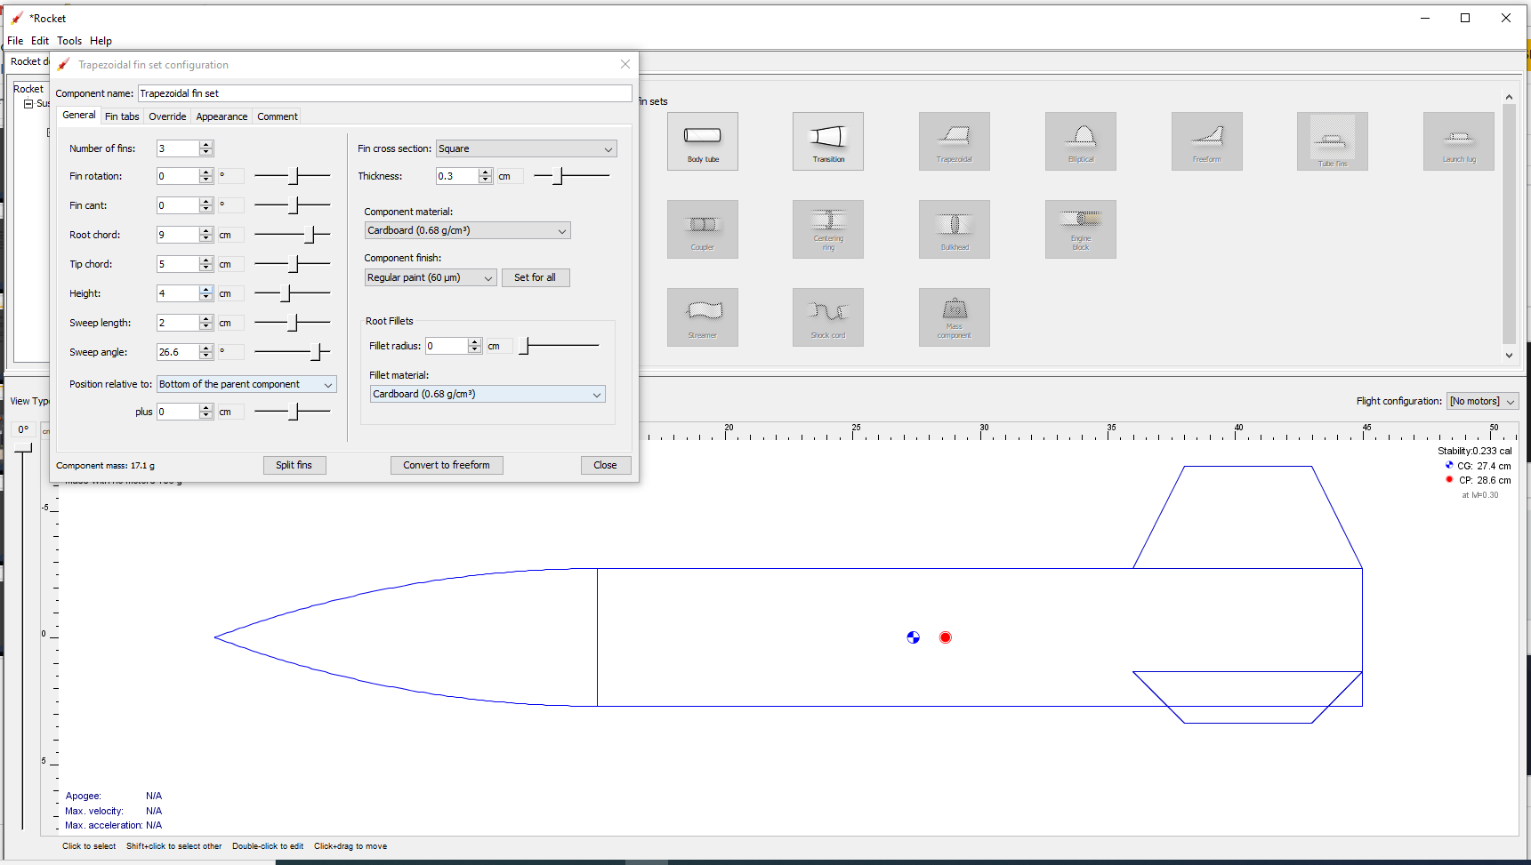
Number of fins: 3
Fin rotation: 0 deg
Fin cant: 0 deg
Root chord: “Length of fin base”
Tip chord: “Length of fin tip
Height: “Height of fin from body tube
Sweep length: “Cos(length of first fin length)”
Sweep angle: “Degree of first fin angle”
Position relative to: “Where you want your fin on the body tube.”
Trapezoidal Fin Explanation

Slide 4
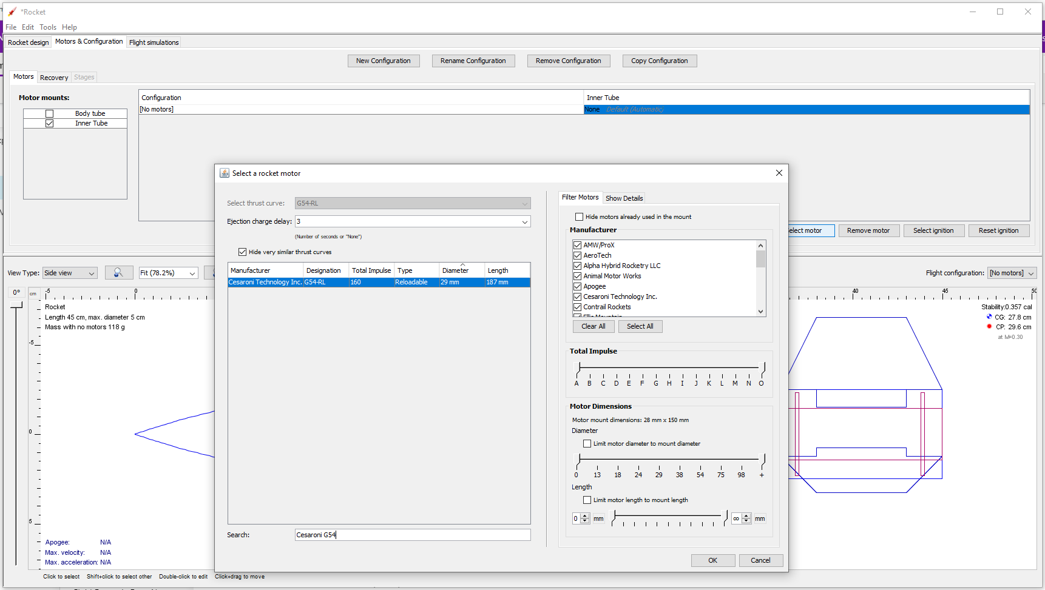
Click: “Motors & Configuration”
Click: Inner Tube in “Motor mounts:”
Click: Inner Tube in “Configuration”
Search: Cesaroni G54 In Ejection charge delay: 12
Click: OK
Motos & Configuration Explanation

Slide 5
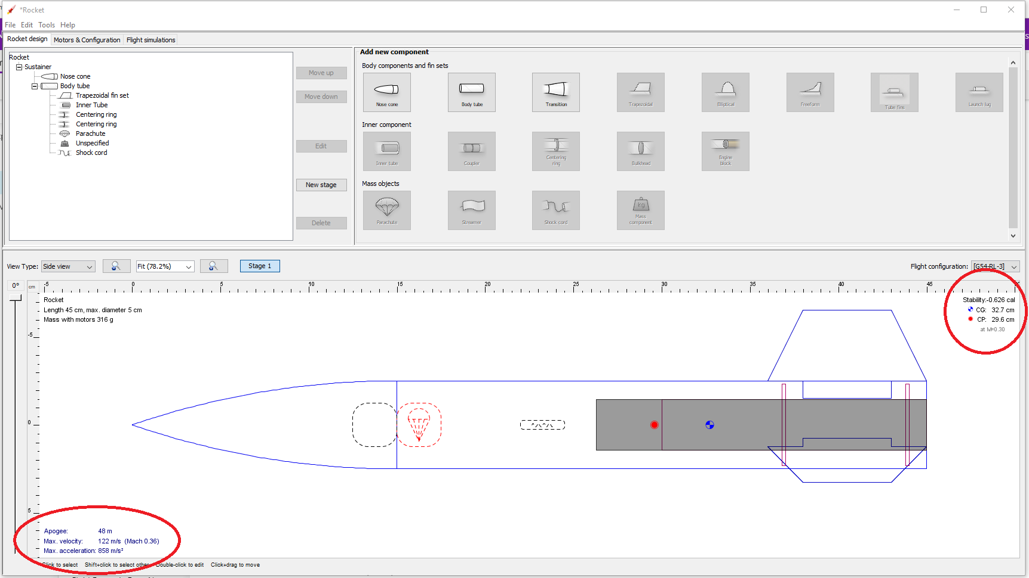
OpenRocket Critical Elements
CG: Center of Gravity
CP: Center of Pressure
CP must be in front of (towards nose cone) CG
Ensure that your stability is a minimum of 1.5! Recognize a balance between Stability and Apogee.

Slide 6
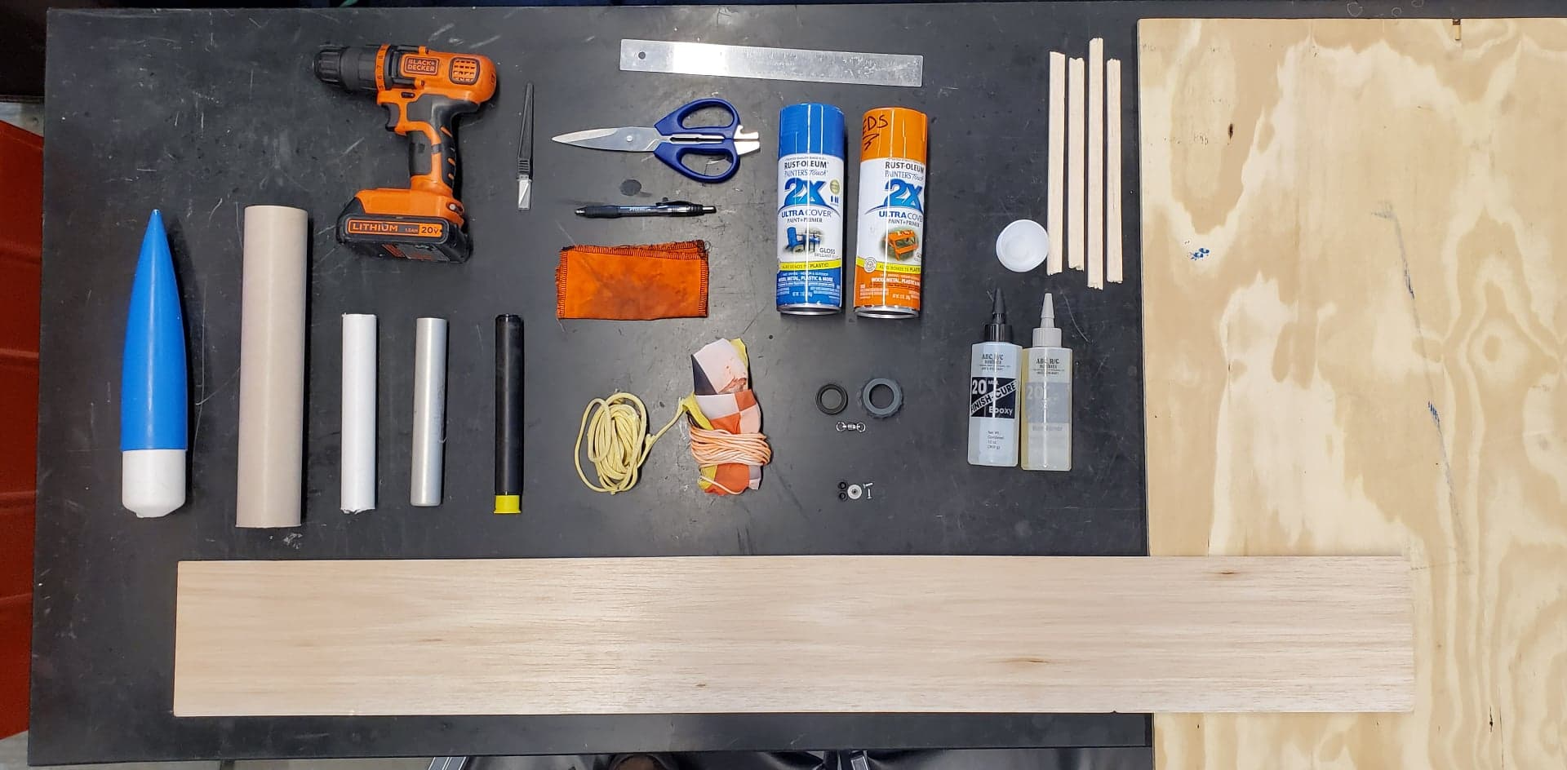
Gathering Supplies
1. Nose Cone.
2.Body Tube.
3.Engine Tube.
4.Engine Casing.
5.Engine.
6.Fin Wood.
7.Drill.
8.Scalpel.
9.Ruler.
10. Scissors.
11. Spray Paint.
12.Stir Rods.
13. Centering Ring Wood.
14. Stir Cups.
15. Epoxy.
16. Aft Retainer.
17. Swivel.
18.Rail Buttons.
19. Parachute.
20. Kevlar.
21. Parachute Protector.
22. Pen.
7
8
9
13
12
10
11
1
2
22
14
3
4
5
21
16
15
19
20
17
18
6

Slide 7
General Safety Rules:
NEVER go into a machine shop without your team lead or an experienced personnel.
ALWAYS wear your safety glasses when in a machine shop.
Be mindful of power tools being used in the room. Ie. Dremel, Drill, ect.
It’s okay to get epoxy on your skin! Just go over to the sink, wash it off with soap and water

Slide 8


Slide 9
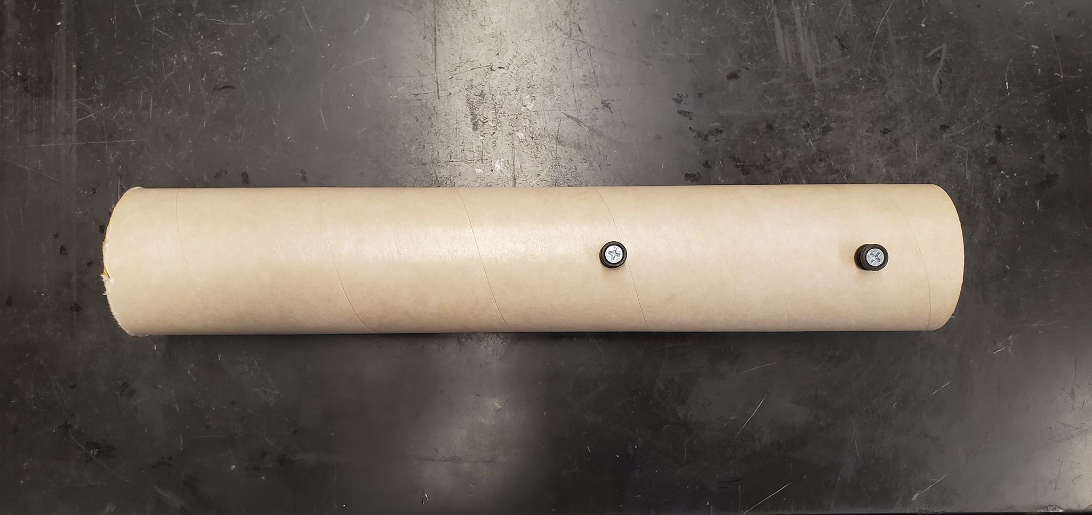
Step #1 Rail Buttons
Align parallel to eachother.
Tip: - Bottom rail button ~1in from bottom
- Top rail button ~1 ft from top

Slide 10
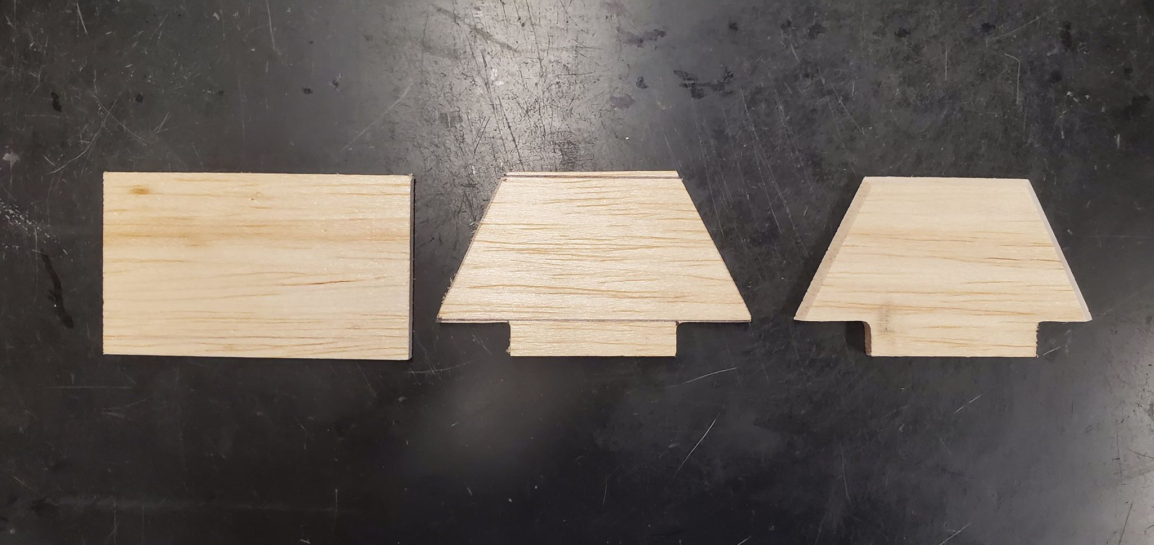
Step #2 Fins
Translating OpenRocket to Balsa wood

Slide 11
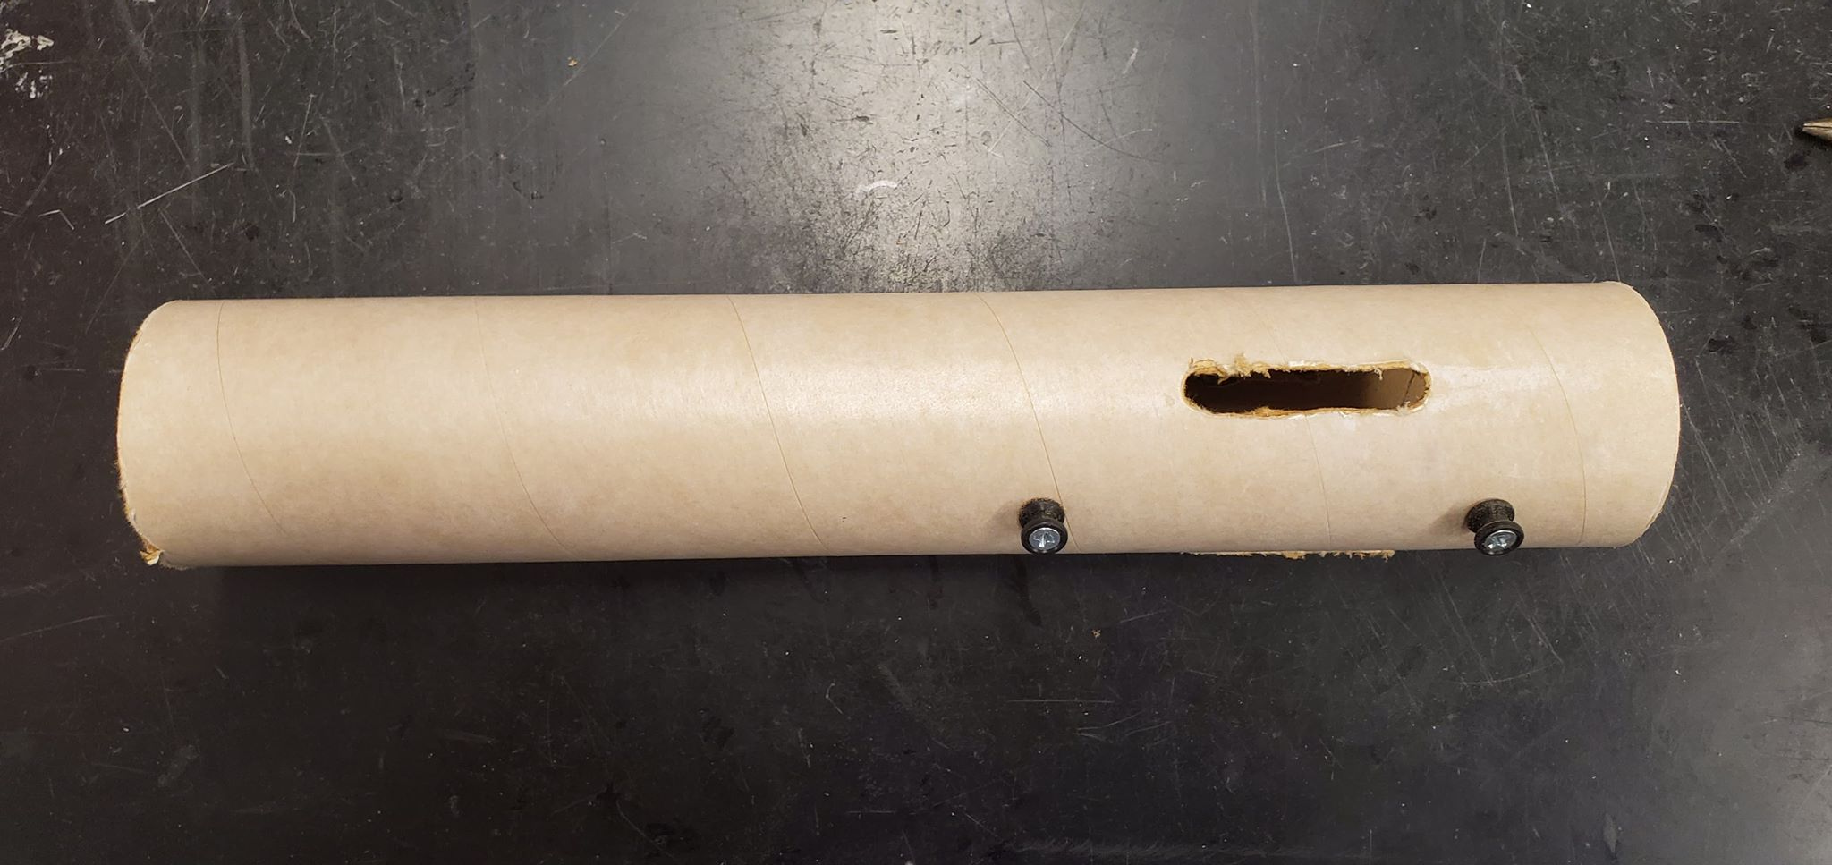
Step #3 Fin Slots
Tip: Check with OpenRocket for correct fin slot length
%Example Fin slots were done quickly, make yours better

Slide 12
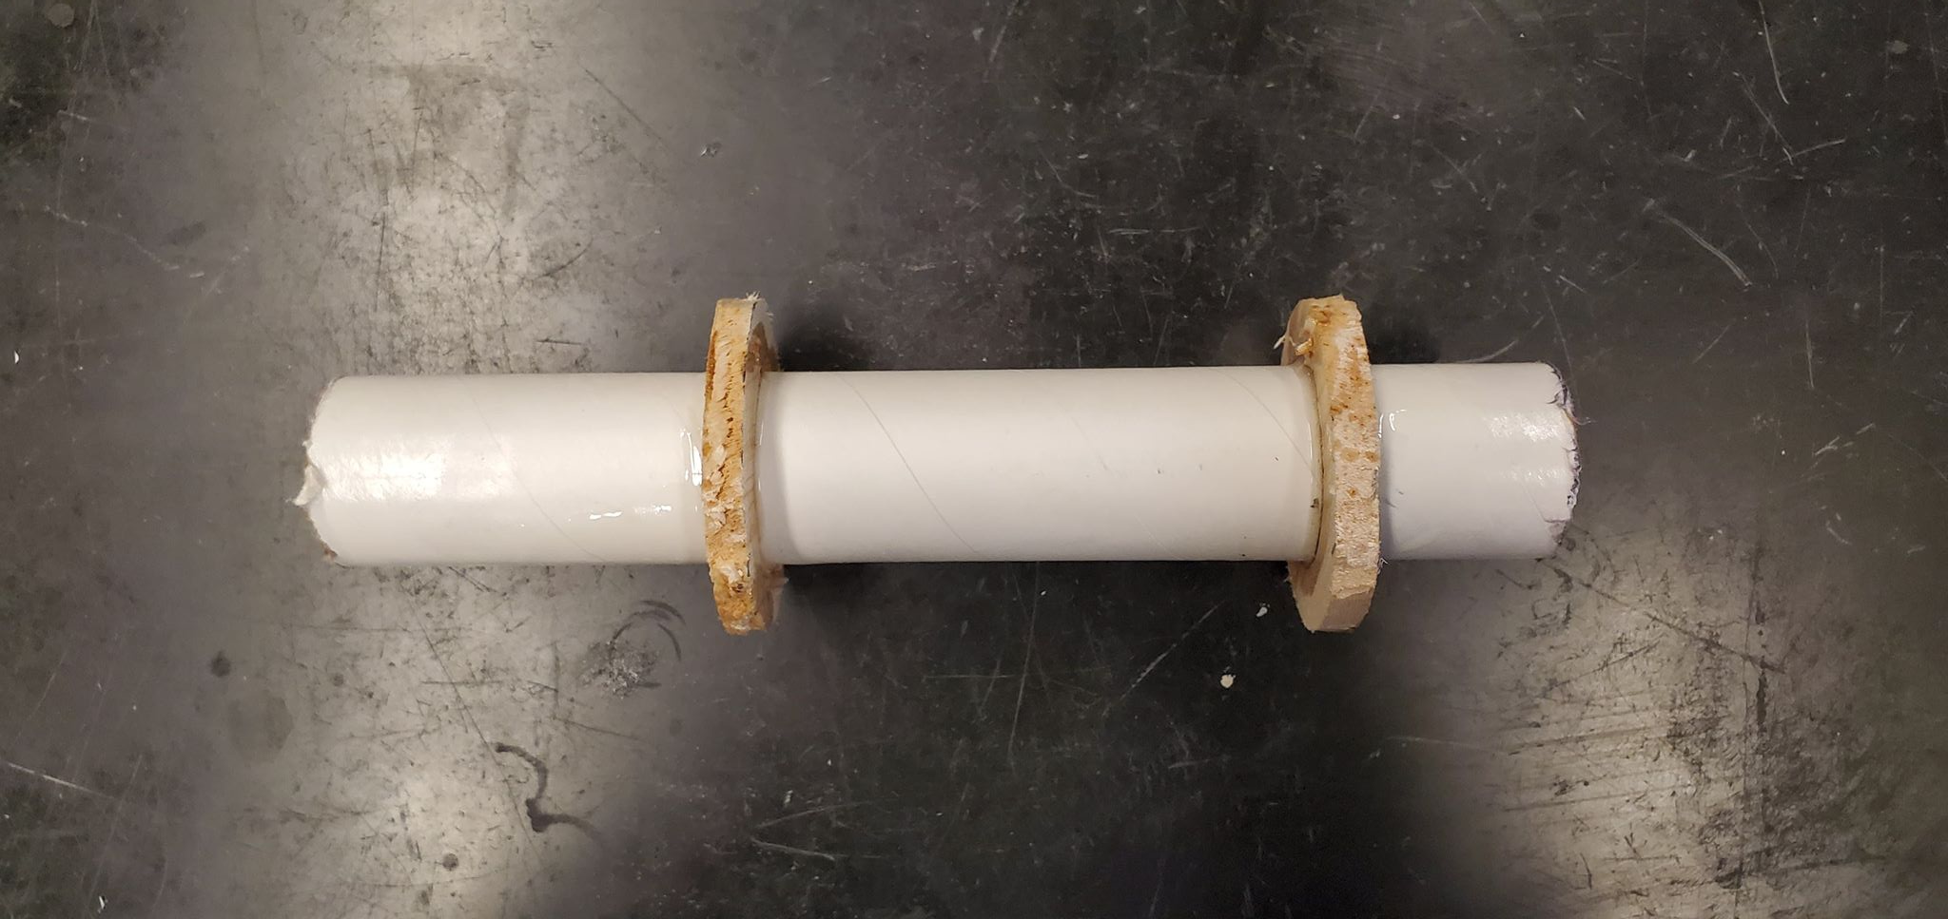
Step #4 Centering Rings
Tip: Drill 2 holes in each centering rings (180 deg apart)
Tip: Epoxy centering rings onto engine tube so that the engine casing will be coincident with the engine tube
Tip: Spin the tube from the inside while epoxy is curing
% It must be concentric

Slide 13
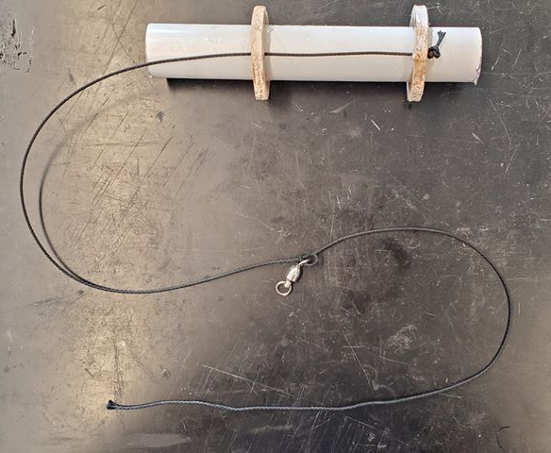
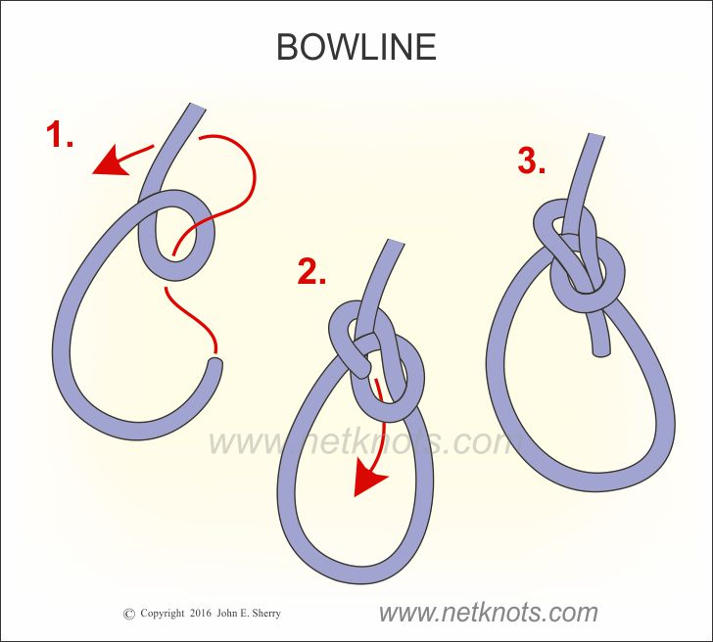
Step #5 Parachute and Nose Cone line.
Tip: The line should be 3 body tube lengths long
%One length from the end of the centering rings to the end of the body tube, one length from body tube to the swivel, one length from the swivel to the parachute

Slide 14
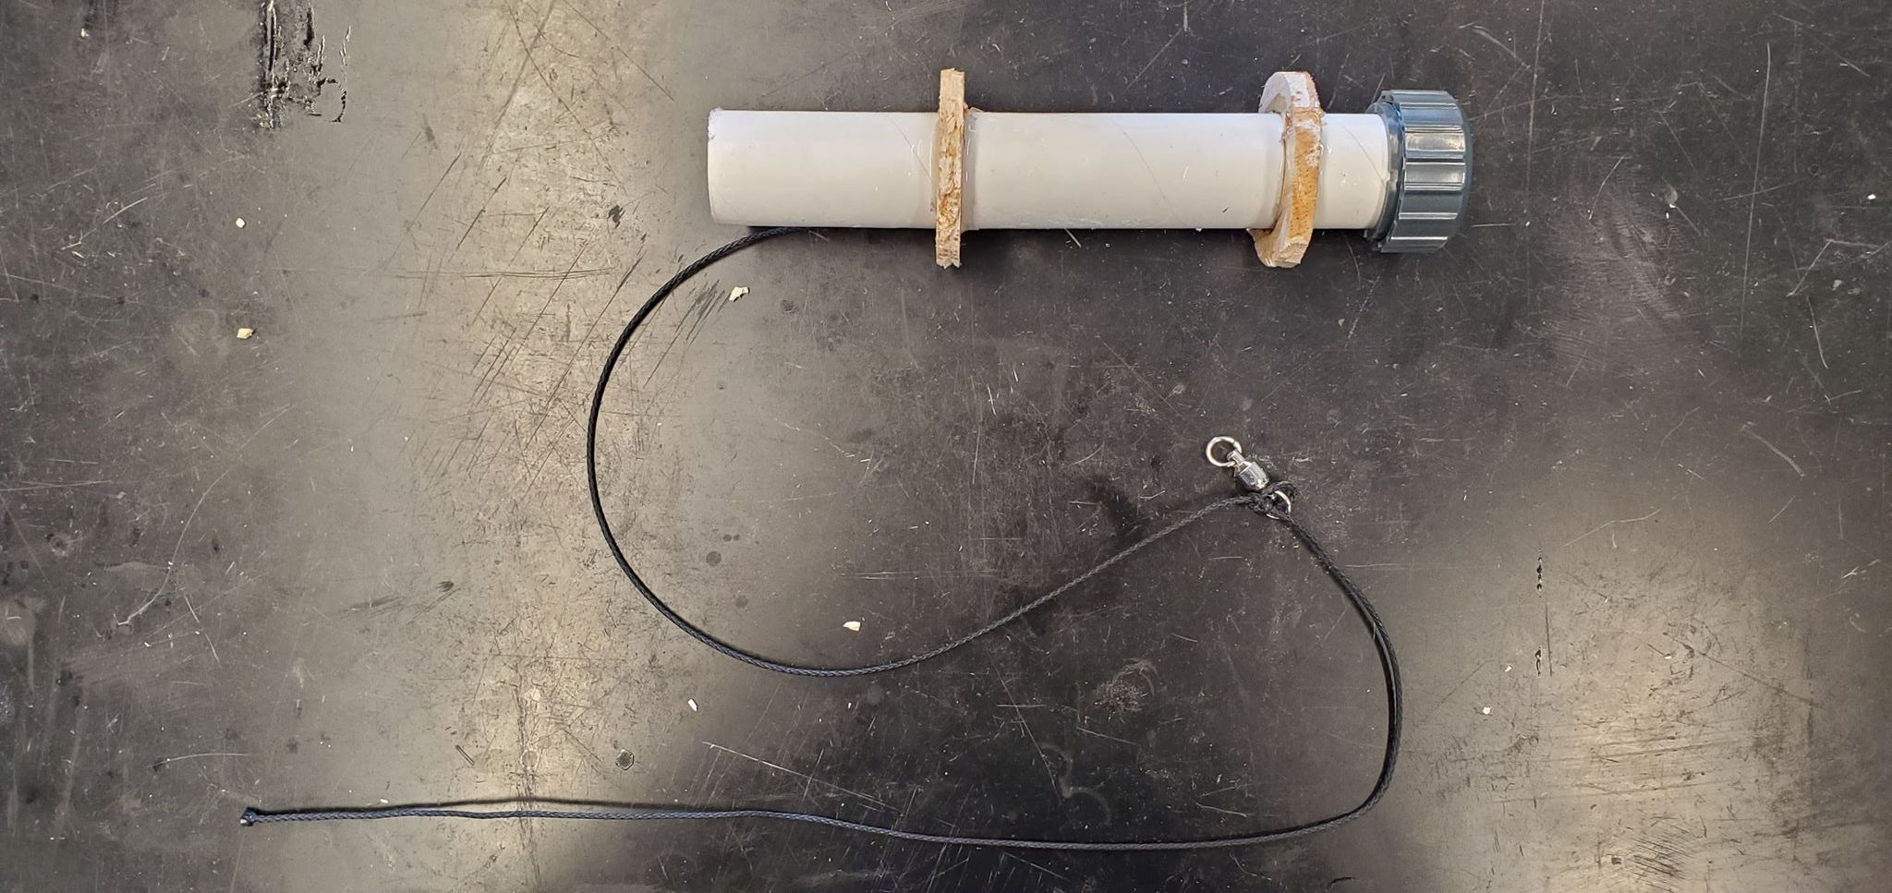
Step #6 Epoxy Aft retainer

Slide 15
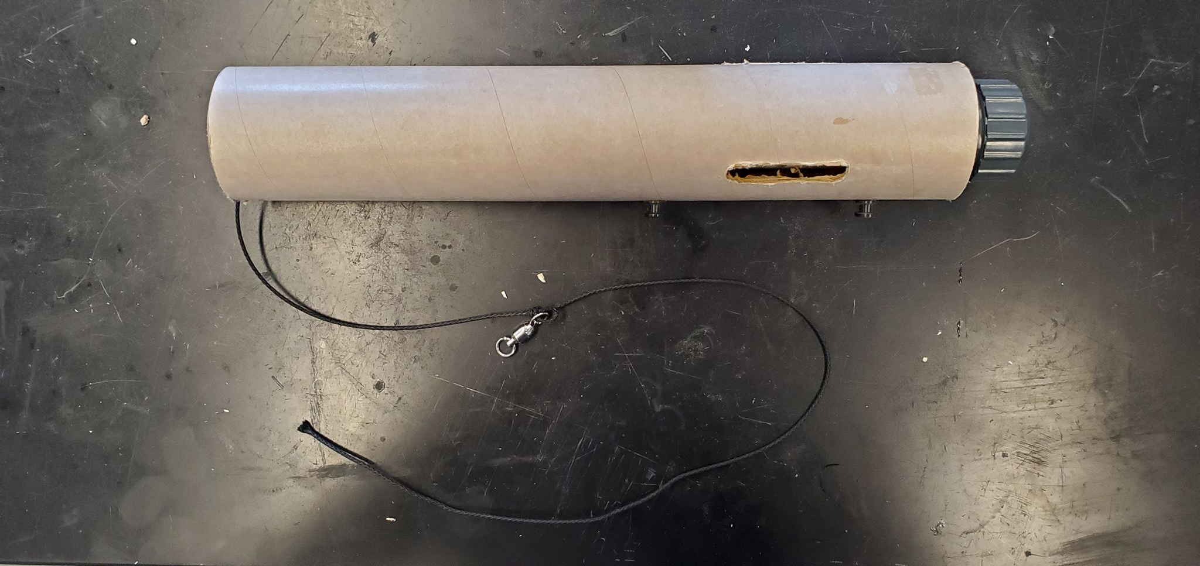
Step #5 Epoxy all engine components
Tip: Dry fit all components, make sure everything fits without interference from any parts.
Tip: Be prepared and work quickly!!!

Slide 16
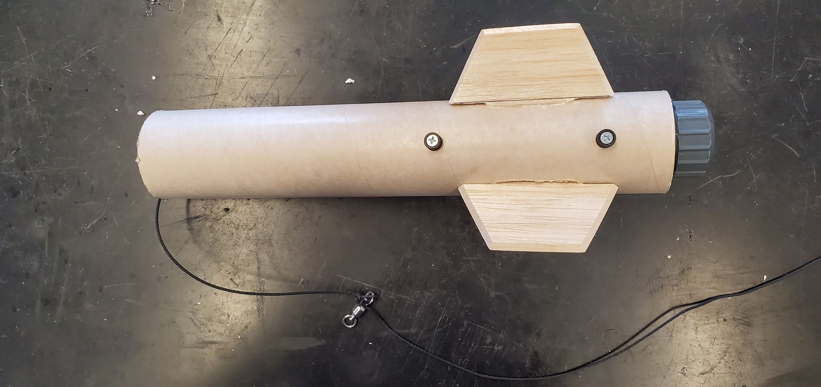
Step #6 Epoxy Fins to body tube and engine tube
Tip: Make each fin 120 deg from each other

Slide 17
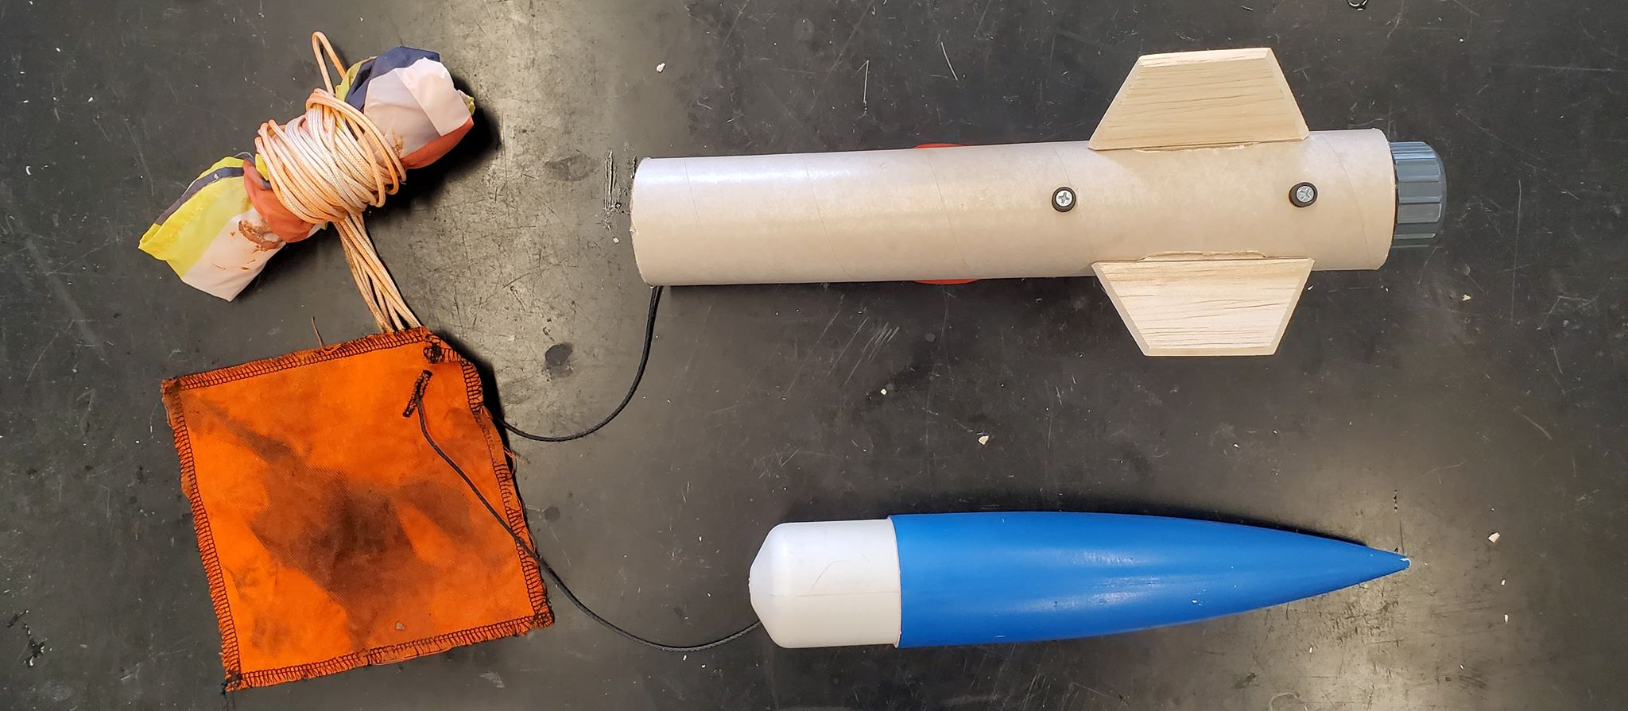
Step #7 Attach Parachute, Parachute protector, Nose Cone

Slide 18
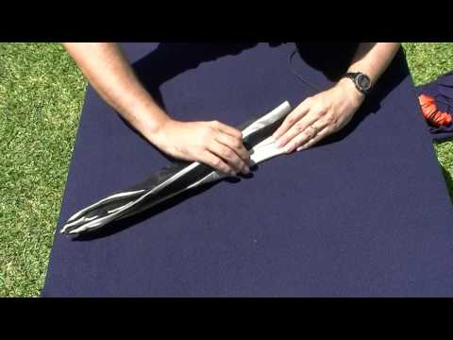
Parachute Organization / How to pack your parachute
Google: “How to fold a parachute in 3 seconds”
Youtube: https://www.youtube.com/watch?v=YWxmotv9kIU

Slide 19
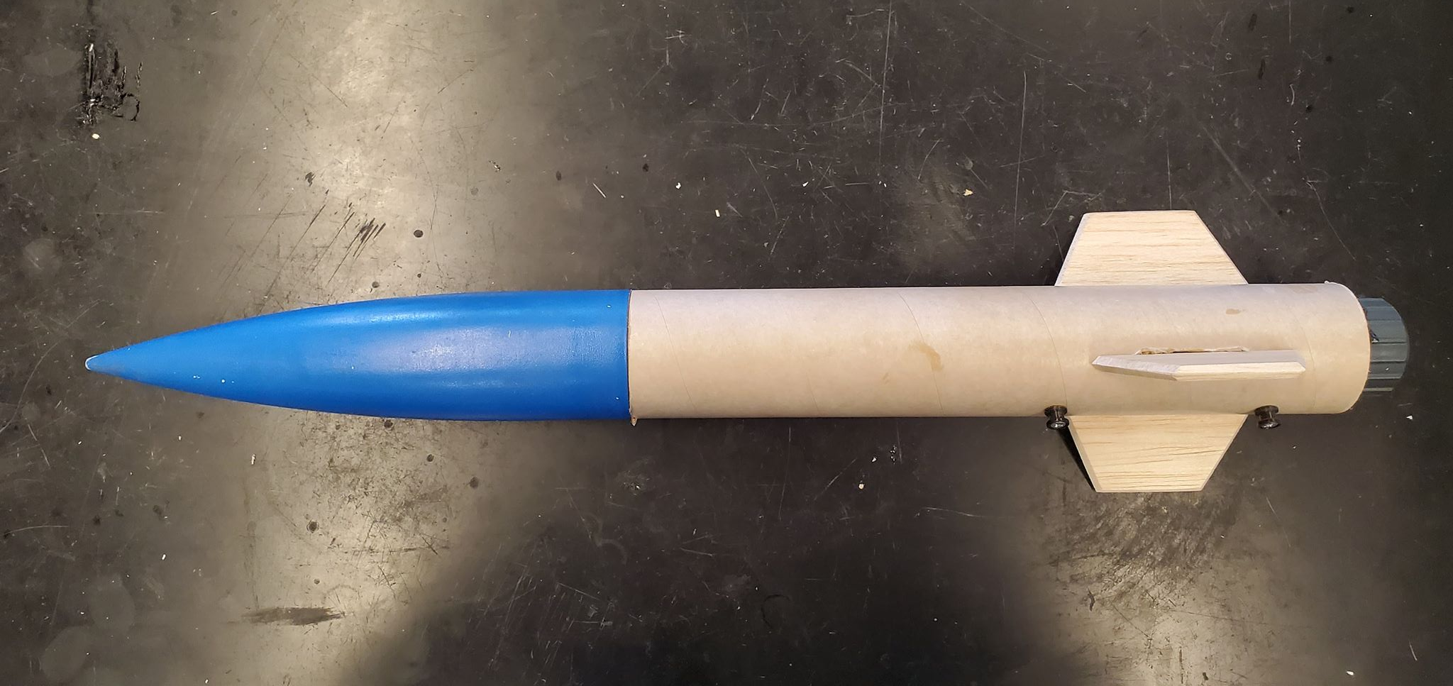
Step #8 Test Assembly and Spray Paint!

